Slide 1
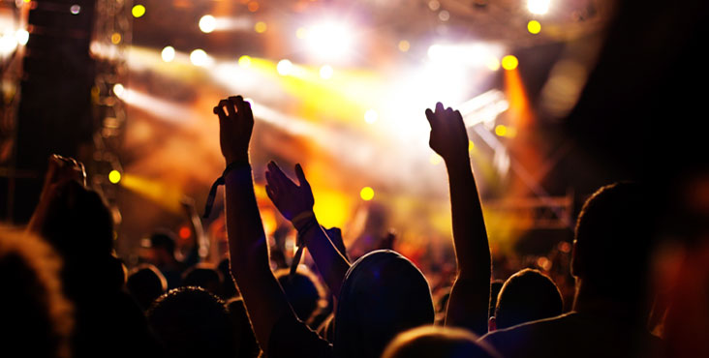

Event Recommender
Dhiviya Dhanasekar | Kushal Palesha |Prathiba Nagarajan

Slide 2
Outline
Why an event recommender?
Implementation
Challenges we faced

Slide 3

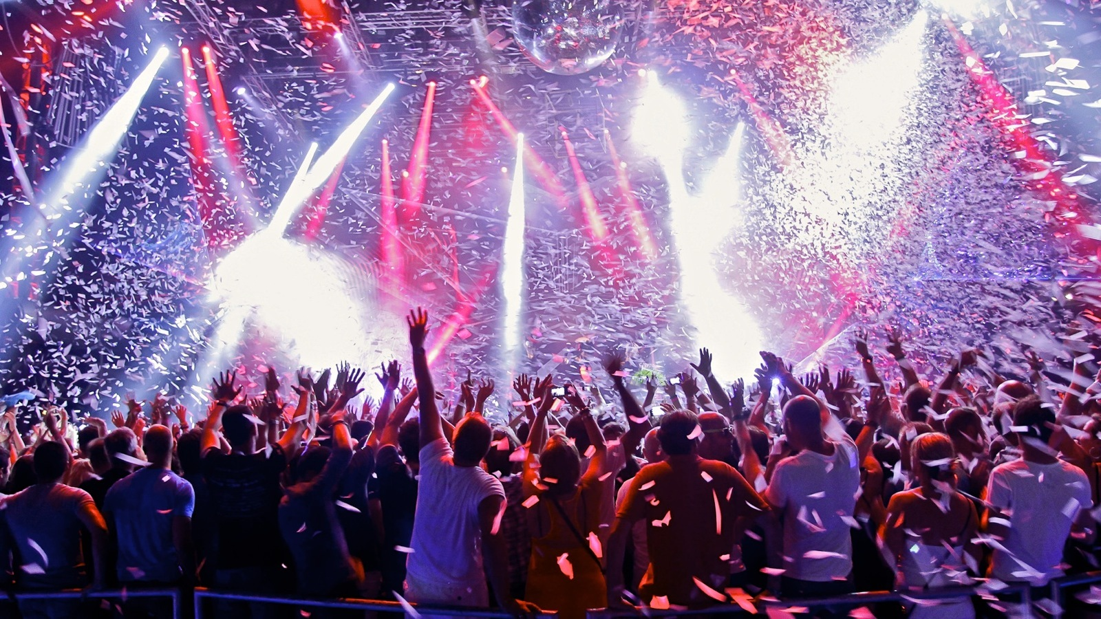

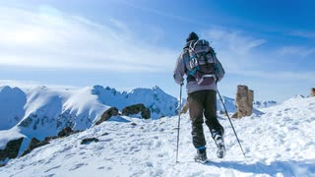

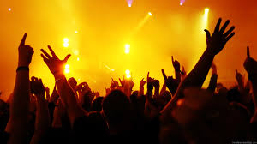
What does Homer like?

Slide 4
Demo
Add screenshot here

Slide 5



How?
Use event descriptions.
Calculate TF-IDF for the 100 most frequently occurring words in the description.
TF – Term Frequency
IDF – Inverse Document Frequency
Use Cosine Similarity to gauge the similarity of the new event to Homer’s likes and dislikes.
Notes:
A lot of data. Too little time. So we decided to focus on event descriptions only. We can definitely improve the recommendation accuracy by using other features.

Slide 6
Why Big Data?
3M events
Notes:
TF-IDF calculation

Slide 7
Using what?
Events
MapReduce
TF - IDF
HBase
MapReduce
Cosine Similarity
Events: Interested & Uninterested
User
Data
MapReduce

Slide 8
Challenges
Too many features/attributes
Environment to run jobs
Bulk Loading into HBase
Out of RAM – GB of data
Excessive Logging
Tuning the number of reducers

Slide 9
Summary
Tables
original csv
Transformed table
Cosine similarity
result

Slide 10
Appendix
Github URL: https://github.com/dhiviyadhanasekar/Events_Recommender
Dataset: https://www.kaggle.com/c/event-recommendation-engine-challenge/data

